Slide 1
The Current Government Operations Model
Citizens
Touch Point
Touch Point
Touch Point
Touch Point
Touch Point
Touch Point
Program-
Specific Work
Program-
Specific Work
Program-
Specific Work
Program-
Specific Work
Program-
Specific Work
Program-
Specific Work
Human
Resources
Human
Resources
Human
Resources
Human
Resources
Human
Resources
Human
Resources
Administrative
Services
Administrative
Services
Administrative
Services
Administrative
Services
Administrative
Services
Administrative
Services
Finance
Finance
Finance
Finance
Finance
Finance
Raw Data
Pool
Raw Data
Pool
Raw Data
Pool
Raw Data
Pool
Raw Data
Pool
Raw Data
Pool
Information
Technology
Information
Technology
Information
Technology
Information
Technology
Information
Technology
Information
Technology
Education
Human
Services
Revenue
Labor
Commerce
Public Safety
Gopal Khanna, Chief Information Officer, State of Minnesota - 2010

Slide 2
The New Government Operations Model
Citizens
SINGLE TOUCH POINT
Program Specific Experts
E
D
U
C
A
T
I
O
N
R
E
V
E
N
U
E
C
O
M
M
E
R
C
E
HUMAN
SERVICES
LABOR
PUBLIC
SAFETY
SECURE HARMONIZED DATA POOL
SHARED SERVICES PLATFORM
Gopal Khanna, Chief Information Officer, State of Minnesota - 2010

Slide 3
THE COMMISSION ON SERVICE INNOVATION: FIRST ANNUAL STRATEGIC PLAN & REPORT TO THE LEGISLATURE
Humphrey Institute
Gopal Khanna, Lead Commission Co-Chair (2010)
January 12, 2011

Slide 4
What is CSI?
CSI, or the Commission, was created in 2010 by the legislature and governor
Bi-partisan authors and support
Sen. Terri Bonoff (DFL – District 43)
Rep. Keith Downey (R – District 41A)
Mission
Commission on Service Innovation
“Reengineer the delivery of state and local government services”

Slide 5
The CSI team was…
Diverse
Public-private
Balanced
Knowledgeable
Pragmatic
Operational
Creative
Future-oriented
Results-focused
Membership
Business Community (Chamber, Business Partnership, MHTA)
Non-Profits (Bush, Citizens League, Nonprofits Council, Wilder)
Local Gov’t (AMC-Counties, League of MN Cities, MAT-Townships)
Education (MNSCU, U. of MN)
Gov’t Employee Unions
(AFSCME, MAPE, SEIU)
State Chief Information Officer

Slide 6
What did the group do?
Full CSI
(monthly meetings since July 2010)
Advisory Working Sub-Groups
Problem Definition / Opportunity
Visioning / Steering
Shared Services
Workforce / Culture
Process / Governance
Citizen / Customer Engagement

Slide 7
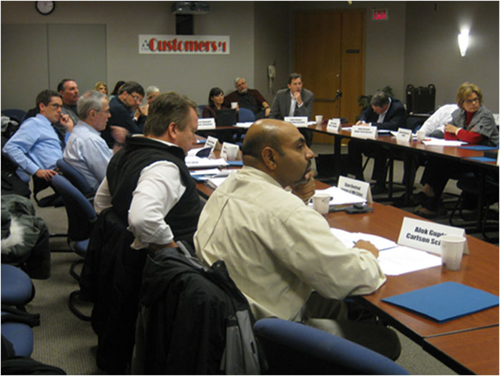
CSI at work

Slide 8
What did CSI find?
Even after the recession ends, the state will still face daunting challenges that arise from changing demographic and economic realities
Shifts in Minnesota’s population, coupled with slower state revenue growth, increased health care costs and continued prioritization of K-12 spending, all add up to create major budget challenges in the future

Slide 9
What did CSI find?
In a nutshell… Assuming revenue grows 3.9% per year, health care continues to grow at 8.5% and spending on K-12 education grows by 2% per year for the next 25 years…
…all other segments of the budget will have to be reduced by 3.9% each year to avoid budget deficits
This would nearly eliminate all other areas of spending by 2035

Slide 10
What does CSI recommend?
Key recommendations include:
Establish an enterprise Shared Services/ Consolidation Initiative for state and local entities
Consider new approaches to budgeting, like “Budgeting for Outcomes”
Consider permitting or creating Charter Agencies or Performance-Based Organizations

Slide 11
What does CSI recommend?
Extend the State’s Lean Program to all government entities and include business process reengineering
Create a quasi-gov’t entity, such as a “Public Corporation,” to provide innovation incentives
Grants and investments for willing governments
Create a funding mechanism – Revolving Fund for Innovation, supported by private investments, savings, bonds, etc.
Improve data access and electronic government

Slide 12
What will be the result?
Help state and local governments “deal with” the likely coming budget cuts
Realize substantial savings…at some point*
Reduce service costs and improve quality
* Even if all these recommendations were collectively able to achieve a mere 1% reduction in the cost of government, this would generate at least $250 million in annual savings

Slide 13
Will gov’t employees be impacted?
The Commission believes management and labor need to partner to transform gov’t
MAPE, SEIU and AFSCME all participated in CSI
Employee layoffs will not likely occur due to these recommendations, but…
These recommendations can help realign service delivery with the wave of coming retirements

Slide 14
Next Steps
Seek public and legislative input and support for CSI recommendations
Work with legislators, leaders and stakeholders
Help draft and adopt legislative language, guide early implementation of approved initiatives
Continue to meet and explore specific issue areas for reform, such as K-12 education, health care, etc.

Slide 15
More Information
Legislative Coordinating Commission hosted website on CSI
Full report, meeting videos, presentations, meeting materials and notices
Links to Facebook and Twitter pages. Please give us your feedback and more ideas!
http://www.commissions.leg.state.mn.us/csi/csi.html

